Slide 1
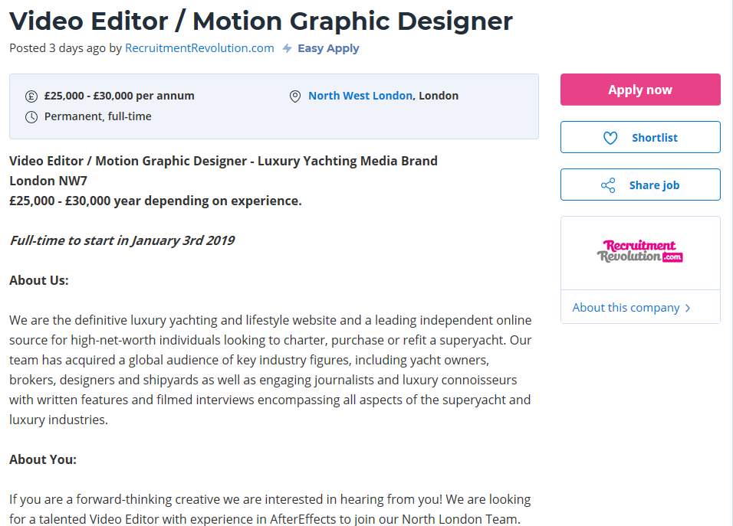
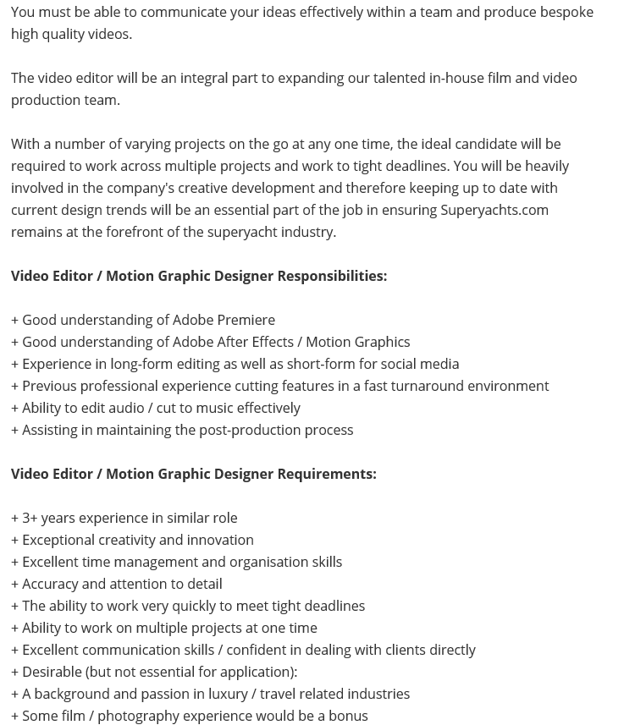

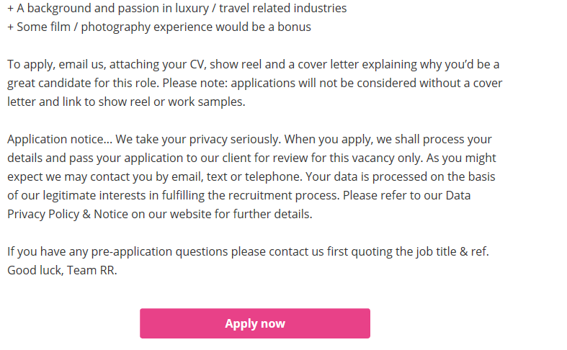


Slide 2
Description:
I found this apprenticeship on a website called Reed.co.uk. It gives you all the information and skills you need to apply. I found a job called ‘Video Editor / Motion Graphic Designer’ I felt like it was a good job role for me because I've had loads of experience in editing and being around social media. I've got a portfolio of work between 3 different blog sites within the 3 years. I will be creating a cover letter for this job role to speak about why I think ill be suitable for the job.

